Slide 1
HIS 215:Civilizations of Asia
Survey of East Asia
Physical and Cultural Landscapes

Slide 2
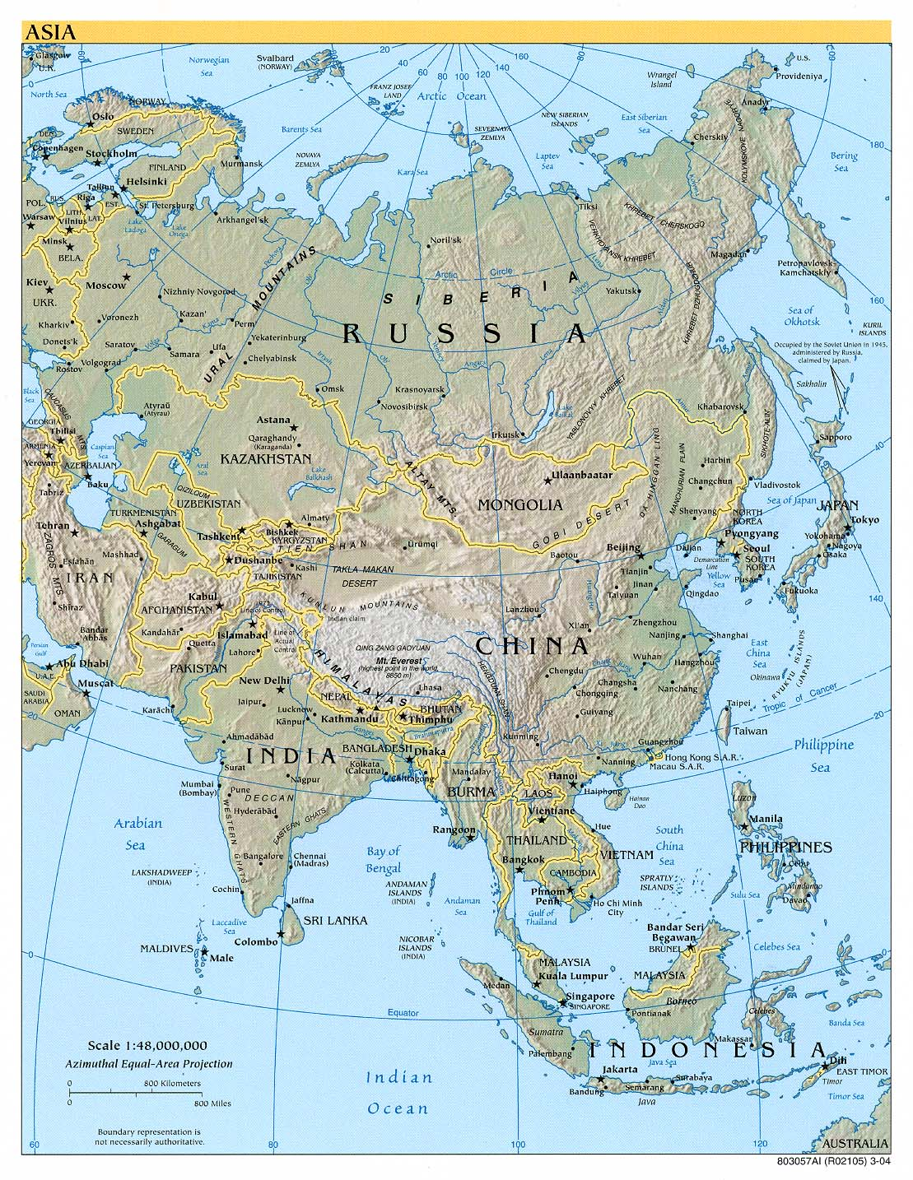

Slide 3
Differences
North: (largely) flat, dry, cool; a grain-producing region
Few river systems in the North
Monsoon seasons have little effect in the North
South: mountainous, wet, warm “land of rice and fish”
Many river systems in the South
Monsoons have strong effect on agricultural and mercantile activity in the South

Slide 4
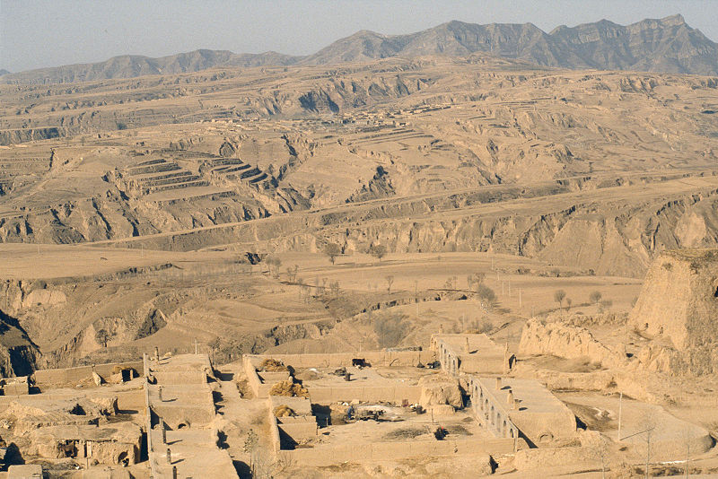
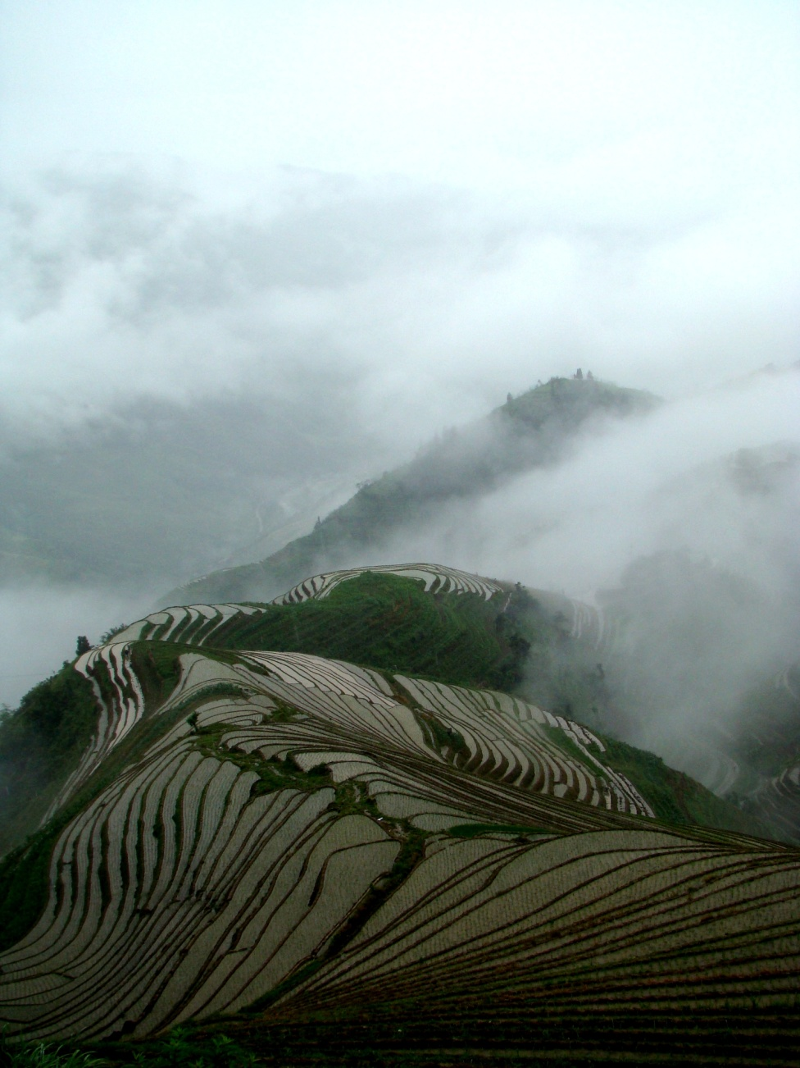

Slide 5
EAST ASIA’S GEOGRAPHY AND ITS HISTORICAL SIGNIFICANCE
High mountains and set off East Asia from surrounding regions.
World centers of civilization: WEST (Mesopotamia, Greece, and Egypt), INDIAN SUBCONTINENT (Indus Valley of NW India), EAST (North China Plain)
Vast expanses of water to east focused much inter-regional activity. Large landmass of Central Asia determines climate for the entire region.
System of rivers carried trade and the exchange of ideas from China's Central Plains toward the east and south.

Slide 6
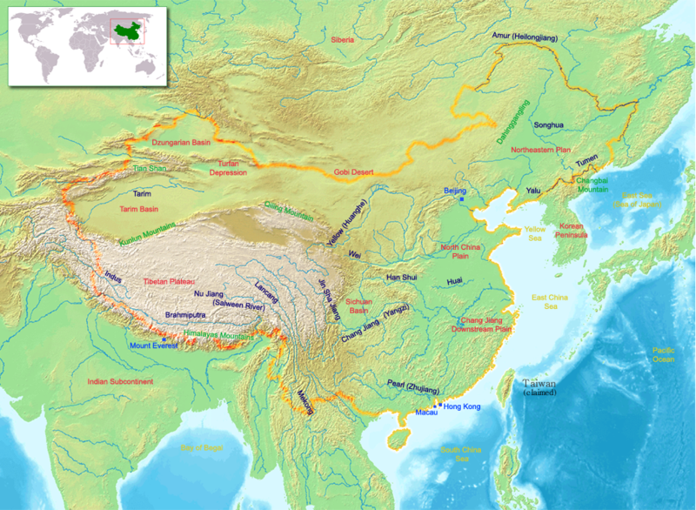

Slide 7
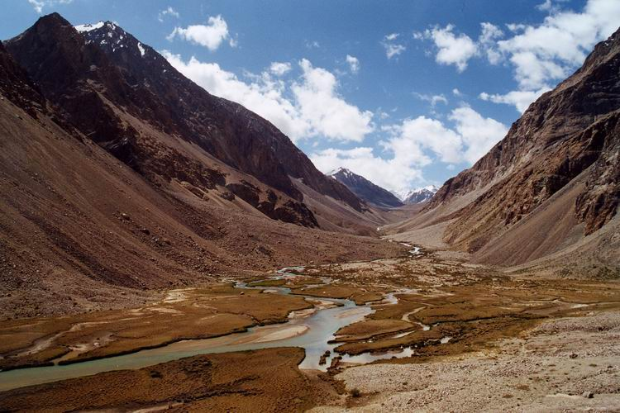
High mountains set off East Asia from surrounding regions
Limited, but did not eliminate inter-regional contact across Eurasia.

Slide 8
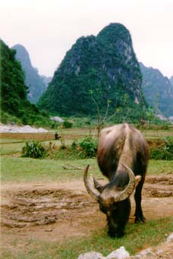
Largest area of highly productive farmland in the world
Agricultural pressures shaped the philosophical, social and political values of the region.
Population pressures grow through history; The inhabited part of China is about 1/2 the size of the inhabited part of the US, but it supports about five times as many people.

Slide 9
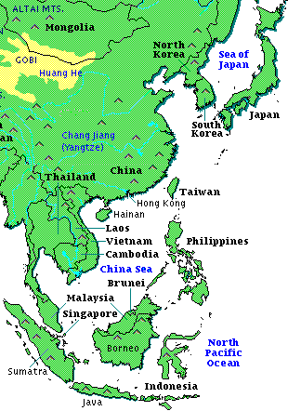
Vast expanses of water focused much inter-regional activity
A system of currents flowed north from the Philippine archipelago past the Japanese archipelago
A system of rivers carried trade and the exchange of ideas from China's Central Plains toward the east and south
Exchange was a “two way street”
Images source: http://acc6.its.brooklyn.cuny.edu/~phalsall/images/easiamap.gif

Slide 10
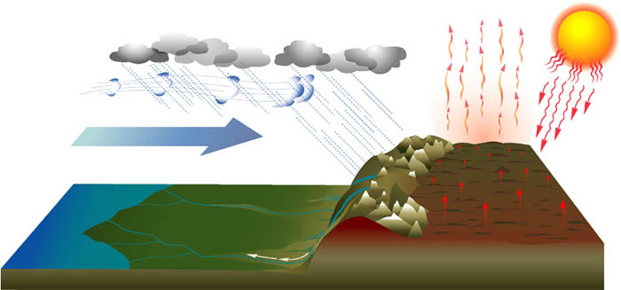
Large landmass of Central Asia determines climate for region

Slide 11

“Monsoon Asia” Southern East Asia and all of Southeast Asia
The Monsoon is an annual cycle of winds, which, because it carries heavy seasonal rains with it, dominates the biological and thus agricultural cycle in Southern China and Southeast Asia.
Before the invention of mechanically powered ships, the Monsoon dominated trading patterns within Southeast Asia and between Southeast Asia and the rest of the world.

Slide 12
THE COMMON CULTURE OF EAST ASIA
Ancestors and the Familial Cult
Inner/Outer “Sphere of Influence” in Gender Relations
Nomads, Farmers, the Great Wall, and the Silk Road

Slide 13
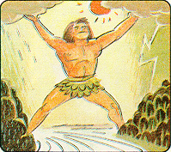
Questions?

